Slide 1
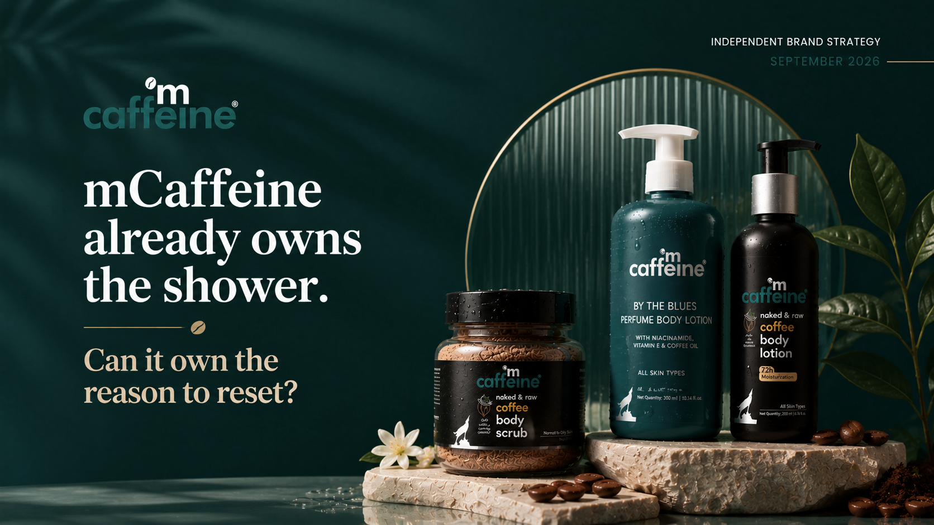

Slide 2


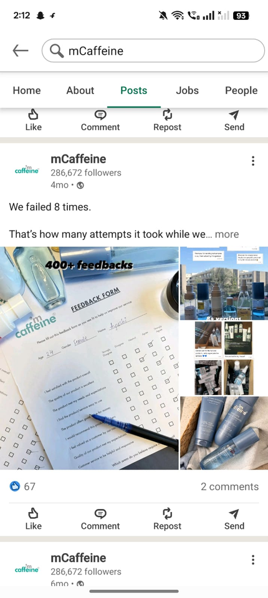

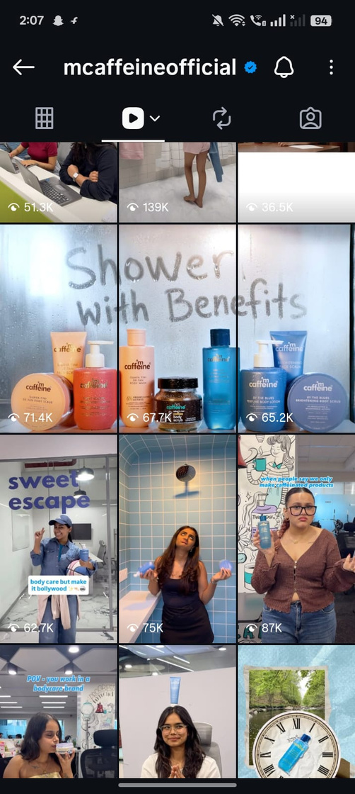
WHERE mCAFFEINE MEETS THE CONSUMER
INSTAGRAM
LINKEDIN
Credibility + Employer Brand
280K+ followers*
Company • People • Culture
Corporate & talent touchpoint
Discovery + Engagement
Reels • Creators • Products • Community
Primary consumer-social touchpoint
mCaffeine has the touchpoints.
The opportunity is to connect the journey.
DISCOVER → ENGAGE → BUY → RETURN
Turn social attention into repeatable purchase occasions.

Slide 3
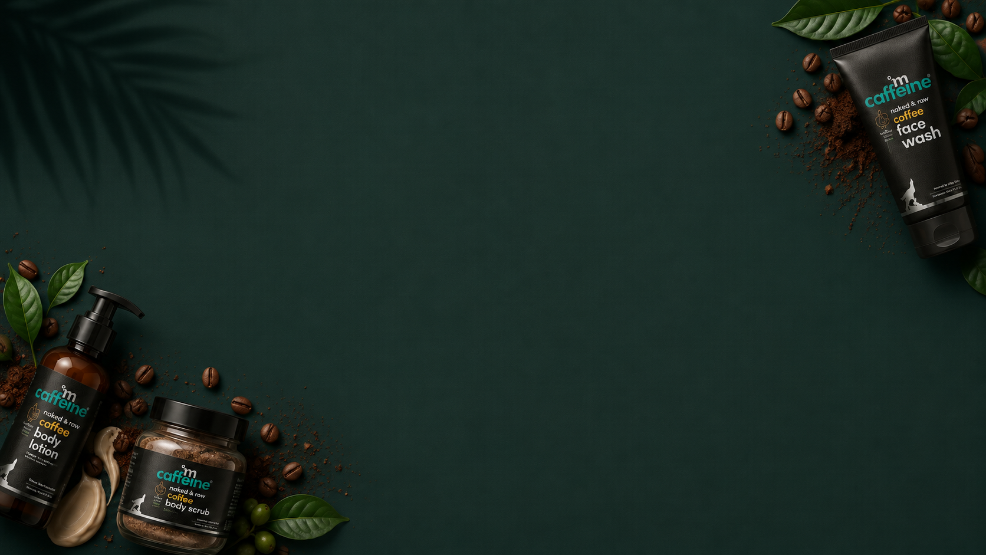







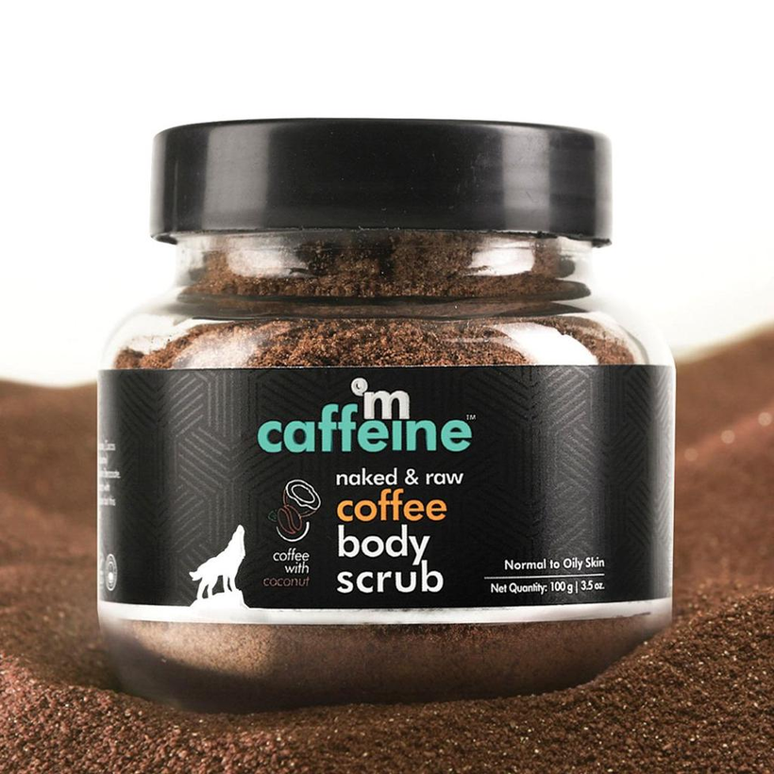
THE COMPETITION OWNS DIFFERENT MINDSETS.
SCIENCE-LED
mCAFFEINE CAN OWN THE RESET RITUAL.
LIFESTYLE + EXPERIENCE
PRODUCT → ROUTINE → RITUAL
PROBLEM → SOLUTION
SCIENCE + VEGAN BEAUTY
GOOGLE SEARCH INTEREST
Dot & Key ███████████ 55
Minimalist ██████████ 53
The Derma Co █████████ 45
Plum █████ 26
WishCare █████ 25
mCaffeine ███ 17
From coffee-powered products → to a repeatable self-care ritual.

Slide 4
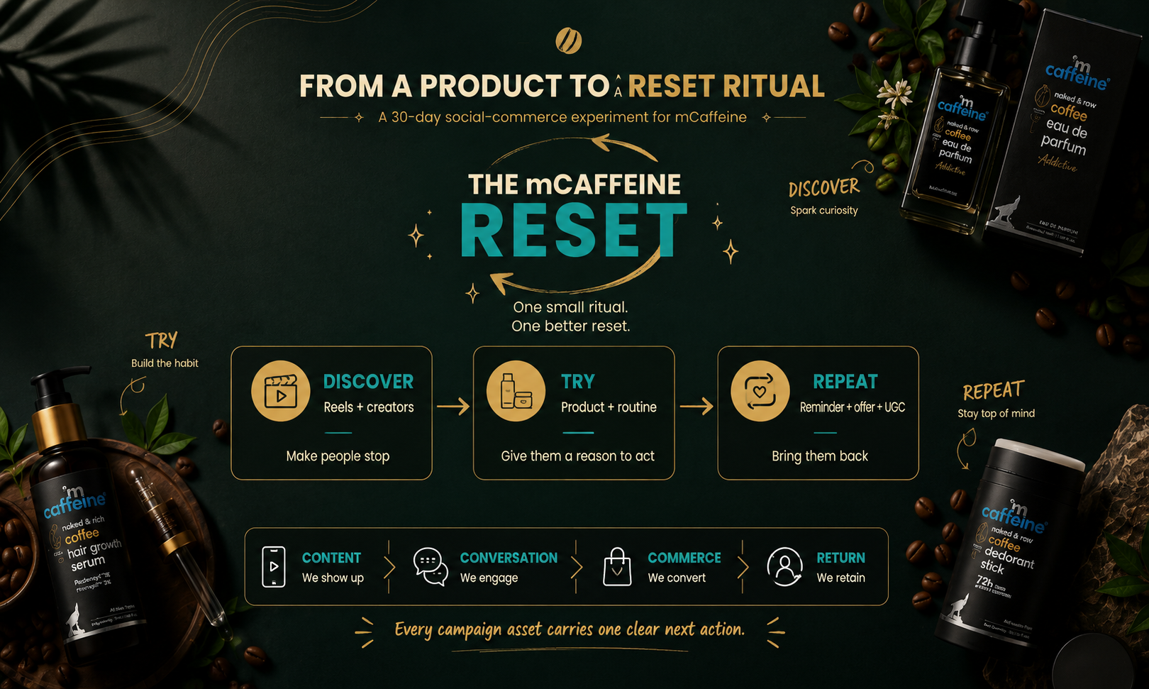

Slide 5
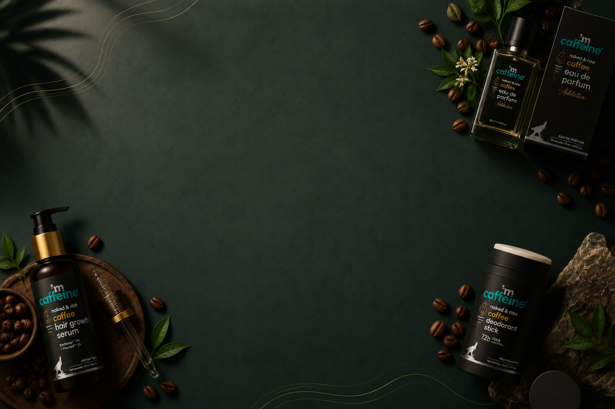

FROM ATTENTION TO REPEAT PURCHASE
REACH
👀
ENGAGEMENT
🗨️
CONVERSION
RETENTION
Qualified discovery
Saves • Shares • Comments
Clicks • Cart • Orders
Repeat • UGC • CRM
🛍️
🔄
THE GOAL ISN'T ONE VIRAL POST.
IT'S A REPEATABLE PURCHASE LOOP.
Track weekly:
Reach → Engagement → Conversion → Repeat

Slide 6
